Slide 1
Bootstrap Report Development

Slide 2
Introduction
A semisubmersible drilling vessel is being considered for simultaneous drilling and production activities at a 6000 ft water depth offshore Gulf of Mexico.
About Bootstrap:
Bootstrap is a free and open-source front-end web framework for designing websites and web applications. It contains HTML- and CSS-based design templates for typography, forms, buttons, navigation and other interface components, as well as optional JavaScript extensions. Unlike many web frameworks, it concerns itself with front-end development only.

Slide 3
High Level Data Flow
Master File (Contains all data)
- General/project Data
Common data
ANSYS Data (based on common data and should be formula based)
Solidworks Data
For individual analysis
ANSYS, Solidworks, OrcaFlex, Blender, COMSOL etc.
Results for Web report
Web report

Slide 4

Flowchart for ???
Python Scripting Files
D3JS
Is this OrcaFlex specific? Please convert this.
Connect this to the high level dataflow above?
CSV
JavaScript
HTML
CSS
Bootstrap Web Report

Slide 5
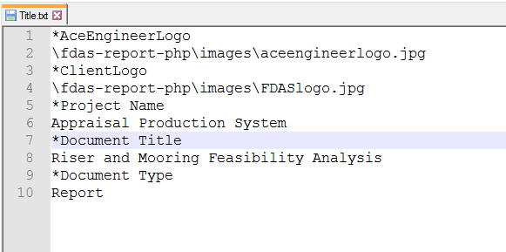
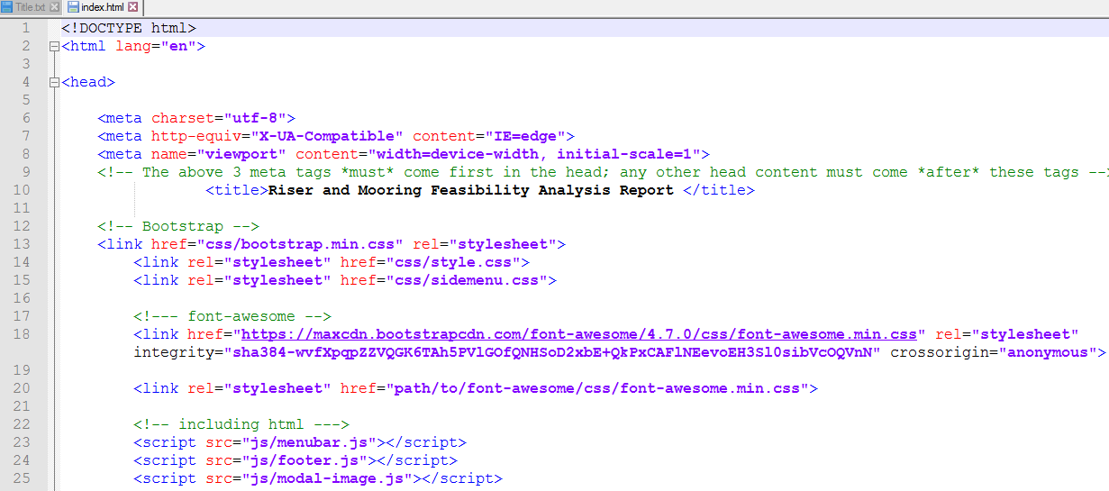
Basic Flowchart for Web Report
Prepare .csv files for charts and tables
(Engineer)
Improve this further.
Prepare .txt files
(Engineer)
Read .txt files and convert to .html files
(Program)
Deploy in Server (Engineer)

Slide 6
Flowchart Process
Step 1:
Python Script can interface directly to Orca flex and derive required chart values.
Step 2:
D3Js is JavaScript library for manipulate documents based on data using HTML, SVG and CSS. Report includes overview, examples, documentation, and source. Python chart values can be modulated by it.

Slide 7
Flowchart Process
Step 3:
CSV file stores tabular data (numbers and text) in plain text as excel format.it was obtained by d3js.
Step4:
To display the generated CSV file, linking the file into bootstrap, functioning terms like scrolling, hovering and for more effective representation in bootstrap web report.
HTML and CSS must be important with JavaScript.

Slide 8
Flowchart Process
Step 5
Bootstrap template is a free source from which we can develop the web report with our required format.
Bootstrap includes CSS, HTML and JavaScript.
CSV derives Data charts into the bootstrap report.

